Slide 1
Guide to Computer Forensics and Investigations
Fifth Edition
Chapter 4
Processing Crime and Incident Scenes
Notes:
Guide to Computer Forensics and Investigations Fifth Edition
Chapter 4
Processing Crime and Incident Scenes

Slide 2
Objectives
Explain the rules for controlling digital evidence
Describe how to collect evidence at private-sector incident scenes
Explain guidelines for processing law enforcement crime scenes
List the steps in preparing for an evidence search
Describe how to secure a computer incident or crime scene
Guide to Computer Forensics and Investigations Fifth Edition
Notes:
Objectives
Explain the rules for controlling digital evidence
Describe how to collect evidence at private-sector incident scenes
Explain guidelines for processing law enforcement crime scenes
List the steps in preparing for an evidence search
Describe how to secure a computer incident or crime scene

Slide 3
Objectives
Explain guidelines for seizing digital evidence at the scene
List procedures for storing digital evidence
Explain how to obtain a digital hash
Review a case to identify requirements and plan your investigation
Guide to Computer Forensics and Investigations Fifth Edition
Notes:
Objectives
Explain guidelines for seizing digital evidence at the scene
List procedures for storing digital evidence
Explain how to obtain a digital hash
Review a case to identify requirements and plan your investigation

Slide 4
Identifying Digital Evidence
Digital evidence
  Can be any information stored or transmitted in digital form
Courts accept digital evidence as physical evidence
  Digital data is treated as a tangible object
Groups such as the Scientific Working Group on Digital Evidence (SWGDE) set standards for recovering, preserving, and examining digital evidence
Guide to Computer Forensics and Investigations Fifth Edition
Notes:
Identifying Digital Evidence
Digital evidence
Can be any information stored or transmitted in digital form
U.S. courts accept digital evidence as physical evidence
Digital data is treated as a tangible object
Groups such as the Scientific Working Group on Digital Evidence (SWGDE) set standards for recovering, preserving, and examining digital evidence

Slide 5
Identifying Digital Evidence
General tasks investigators perform when working with digital evidence:
  Identify digital information or artifacts that can be used as evidence
  Collect, preserve, and document evidence
  Analyze, identify, and organize evidence
  Rebuild evidence or repeat a situation to verify that the results can be reproduced reliably
Collecting digital devices and processing a criminal or incident scene must be done systematically
Guide to Computer Forensics and Investigations Fifth Edition
Notes:
Identifying Digital Evidence
General tasks investigators perform when working with digital evidence:
Identify digital information or artifacts that can be used as evidence
Collect, preserve, and document evidence
Analyze, identify, and organize evidence
Rebuild evidence or repeat a situation to verify that the results can be reproduced reliably
Collecting digital devices and processing a criminal or incident scene must be done systematically

Slide 6
Understanding Rules of Evidence
Consistent practices help verify your work and enhance your credibility
Comply with your state’s rules of evidence or with the Federal Rules of Evidence
Evidence admitted in a criminal case can be used in a civil suit, and vice versa
Keep current on the latest rulings and directives on collecting, processing, storing, and admitting digital evidence
Guide to Computer Forensics and Investigations Fifth Edition
Notes:
Understanding Rules of Evidence
Consistent practices help verify your work and enhance your credibility
Comply with your state’s rules of evidence or with the Federal Rules of Evidence
Evidence admitted in a criminal case can be used in a civil suit, and vice versa
Keep current on the latest rulings and directives on collecting, processing, storing, and admitting digital evidence

Slide 7
Understanding Rules of Evidence
Data you discover from a forensic examination falls under your state’s rules of evidence
Digital evidence is unlike other physical evidence because it can be changed more easily
  The only way to detect these changes is to compare the original data with a duplicate
Most federal courts have interpreted computer records as hearsay evidence
  Hearsay is secondhand or indirect evidence
Guide to Computer Forensics and Investigations Fifth Edition
Notes:
Understanding Rules of Evidence
Data you discover from a forensic examination falls under your state’s rules of evidence
Or the Federal Rules of Evidence (FRE)
Digital evidence is unlike other physical evidence because it can be changed more easily
The only way to detect these changes is to compare the original data with a duplicate
Most federal courts have interpreted computer records as hearsay evidence
Hearsay is secondhand or indirect evidence

Slide 8
Understanding Rules of Evidence
Business-record exception
  Allows “records of regularly conducted activity,” such as business memos, reports, records, or data compilations
Generally, digital records are considered admissible if they qualify as a business record
Computer records are usually divided into:
  Computer-generated records
  Computer-stored records
Guide to Computer Forensics and Investigations Fifth Edition
Notes:
Understanding Rules of Evidence
Business-record exception
Allows “records of regularly conducted activity,” such as business memos, reports, records, or data compilations
Generally, digital records are considered admissible if they qualify as a business record
Computer records are usually divided into:
Computer-generated records
Computer-stored records

Slide 9
Understanding Rules of Evidence
Computer and digitally stored records must be shown to be authentic and trustworthy
  To be admitted into evidence
Computer-generated records are considered authentic if the program that created the output is functioning correctly
Collecting evidence according to the proper steps of evidence control helps ensure that the computer evidence is authentic
Guide to Computer Forensics and Investigations Fifth Edition
Notes:
Understanding Rules of Evidence
Computer and digitally stored records must be shown to be authentic and trustworthy
To be admitted into evidence
Computer-generated records are considered authentic if the program that created the output is functioning correctly
Usually considered an exception to hearsay rule
Collecting evidence according to the proper steps of evidence control helps ensure that the computer evidence is authentic

Slide 10
Understanding Rules of Evidence
When attorneys challenge digital evidence
  Often they raise the issue of whether computer-generated records were altered or damaged
One test to prove that computer-stored records are authentic is to demonstrate that a specific person created the records
  The author of a Microsoft Word document can be identified by using file metadata
Guide to Computer Forensics and Investigations Fifth Edition
Notes:
Understanding Rules of Evidence
When attorneys challenge digital evidence
Often they raise the issue of whether computer-generated records were altered or damaged
One test to prove that computer-stored records are authentic is to demonstrate that a specific person created the records
The author of a Microsoft Word document can be identified by using file metadata
Follow the steps starting on page 141 of the text to see how to identify file metadata

Slide 11
Understanding Rules of Evidence
The process of establishing digital evidence’s trustworthiness originated with written documents and the “best evidence rule”
Best evidence rule states:
  To prove the content of a written document, recording, or photograph, ordinarily the original writing, recording, or photograph is required
Federal Rules of Evidence
  Allow a duplicate instead of originals when it is produced by the same impression as the original
Guide to Computer Forensics and Investigations Fifth Edition
Notes:
Understanding Rules of Evidence
The process of establishing digital evidence’s trustworthiness originated with written documents and the “best evidence rule”
Best evidence rule states:
To prove the content of a written document, recording, or photograph, ordinarily the original writing, recording, or photograph is required
Federal Rules of Evidence
Allow a duplicate instead of originals when it is produced by the same impression as the original

Slide 12
Understanding Rules of Evidence
As long as bit-stream copies of data are created and maintained properly
  The copies can be admitted in court, although they aren’t considered best evidence
Example of not being able to use original evidence
  Investigations involving network servers
  Removing a server from the network to acquire evidence data could cause harm to a business or its owner, who might be an innocent bystander to a crime or civil wrong
Guide to Computer Forensics and Investigations Fifth Edition
Notes:
Understanding Rules of Evidence
As long as bit-stream copies of data are created and maintained properly
The copies can be admitted in court, although they aren’t considered best evidence
Example of not being able to use original evidence
Investigations involving network servers
Removing a server from the network to acquire evidence data could cause harm to a business or its owner, who might be an innocent bystander to a crime or civil wrong

Slide 13
Collecting Evidence in Private-Sector Incident Scenes
Private-sector organizations include:
  Businesses and government agencies that aren’t involved in law enforcement
Non-government organizations (NGO) must comply with state public disclosure and federal Freedom of Information Act (FOIA) laws
  And make certain documents available as public records
FOIA allows citizens to request copies of public documents created by federal agencies
Guide to Computer Forensics and Investigations Fifth Edition
Notes:
Collecting Evidence in Private-Sector Incident Scenes
Private-sector organizations include:
Businesses and government agencies that aren’t involved in law enforcement
Non-government organizations (NGO) must comply with state public disclosure and federal Freedom of Information Act (FOIA) laws
And make certain documents available as public records
FOIA allows citizens to request copies of public documents created by federal agencies

Slide 14
Collecting Evidence in Private-Sector Incident Scenes
A special category of private-sector businesses includes ISPs and other communication companies
ISPs can investigate computer abuse committed by their employees, but not by customers
  Except for activities that are deemed to create an emergency situation
Investigating and controlling computer incident scenes in the corporate environment
  Much easier than in the criminal environment
  Incident scene is often a workplace
Guide to Computer Forensics and Investigations Fifth Edition
Notes:
Collecting Evidence in Private-Sector Incident Scenes
A special category of private-sector businesses includes ISPs and other communication companies
ISPs can investigate computer abuse committed by their employees, but not by customers
Except for activities that are deemed to create an emergency situation
Investigating and controlling computer incident scenes in the corporate environment
Much easier than in the criminal environment
Incident scene is often a workplace

Slide 15
Collecting Evidence in Private-Sector Incident Scenes
Typically, businesses have inventory databases of computer hardware and software
  Help identify the computer forensics tools needed to analyze a policy violation
    And the best way to conduct the analysis
Corporate policy statement about misuse of digital assets
  Allows corporate investigators to conduct covert surveillance with little or no cause
  And access company systems without a warrant
Guide to Computer Forensics and Investigations Fifth Edition
Notes:
Collecting Evidence in Private-Sector Incident Scenes
Typically, businesses have inventory databases of computer hardware and software
Help identify the computer forensics tools needed to analyze a policy violation
And the best way to conduct the analysis
Corporate policy statement about misuse of digital assets
Allows corporate investigators to conduct covert surveillance with little or no cause
And access company systems without a warrant

Slide 16
Collecting Evidence in Private-Sector Incident Scenes
Companies should display a warning banner and publish a policy
  Stating that they reserve the right to inspect computing assets at will
Corporate investigators should know under what circumstances they can examine an employee’s computer
  Every organization must have a well-defined process describing when an investigation can be initiated
Guide to Computer Forensics and Investigations Fifth Edition
Notes:
Collecting Evidence in Private-Sector Incident Scenes
Companies should display a warning banner and publish a policy
Stating that they reserve the right to inspect computing assets at will
Corporate investigators should know under what circumstances they can examine an employee’s computer
Every organization must have a well-defined process describing when an investigation can be initiated

Slide 17
Collecting Evidence in Private-Sector Incident Scenes
If a corporate investigator finds that an employee is committing or has committed a crime
  Employer can file a criminal complaint with the police
Employers are usually interested in enforcing company policy
  Not seeking out and prosecuting employees
Corporate investigators are, therefore, primarily concerned with protecting company assets
Guide to Computer Forensics and Investigations Fifth Edition
Notes:
Collecting Evidence in Private-Sector Incident Scenes
If a corporate investigator finds that an employee is committing or has committed a crime
Employer can file a criminal complaint with the police
Employers are usually interested in enforcing company policy
Not seeking out and prosecuting employees
Corporate investigators are, therefore, primarily concerned with protecting company assets

Slide 18
Collecting Evidence in Private-Sector Incident Scenes
If you discover evidence of a crime during a company policy investigation
  Determine whether the incident meets the elements of criminal law
  Inform management of the incident
  Stop your investigation to make sure you don’t violate Fourth Amendment restrictions on obtaining evidence
  Work with the corporate attorney on how to respond to a police request for more information
Guide to Computer Forensics and Investigations Fifth Edition
Notes:
Collecting Evidence in Private-Sector Incident Scenes
If you discover evidence of a crime during a company policy investigation
Determine whether the incident meets the elements of criminal law
Inform management of the incident
Stop your investigation to make sure you don’t violate Fourth Amendment restrictions on obtaining evidence
Work with the corporate attorney on how to respond to a police request for more information

Slide 19
Processing Law Enforcement Crime Scenes
You must be familiar with criminal rules of search and seizure
You should also understand how a search warrant works and what to do when you process one
Law enforcement officer may search for and seize criminal evidence only with probable cause
  Refers to the standard specifying whether a police officer has the right to make an arrest, conduct a personal or property search, or obtain a warrant for arrest
Guide to Computer Forensics and Investigations Fifth Edition
Notes:
Processing Law Enforcement Crime Scenes
You must be familiar with criminal rules of search and seizure
You should also understand how a search warrant works and what to do when you process one
Law enforcement officer may search for and seize criminal evidence only with probable cause
Refers to the standard specifying whether a police officer has the right to make an arrest, conduct a personal or property search, or obtain a warrant for arrest

Slide 20
Processing Law Enforcement Crime Scenes
With probable cause, a police officer can obtain a search warrant from a judge
  That authorizes a search and seizure of specific evidence related to the criminal complaint
The Fourth Amendment states that only warrants “particularly describing the place to be searched, and the persons or things to be seized” can be issued
Guide to Computer Forensics and Investigations Fifth Edition
Notes:
Processing Law Enforcement Crime Scenes
With probable cause, a police officer can obtain a search warrant from a judge
That authorizes a search and seizure of specific evidence related to the criminal complaint
The Fourth Amendment states that only warrants “particularly describing the place to be searched, and the persons or things to be seized” can be issued

Slide 21
Understanding Concepts and Terms Used in Warrants
Innocent information
  Unrelated information
  Often included with the evidence you’re trying to recover
Judges often issue a limiting phrase to the warrant
  Allows the police to separate innocent information from evidence
Guide to Computer Forensics and Investigations Fifth Edition
Notes:
Understanding Concepts and Terms Used in Warrants
Innocent information
Unrelated information
Often included with the evidence you’re trying to recover
Judges often issue a limiting phrase to the warrant
Allows the police to separate innocent information from evidence

Slide 22
Understanding Concepts and Terms Used in Warrants
Plain view doctrine (not acceptable in the digital forensics)
  Objects falling in plain view of an officer who has the right to be in position to have that view are subject to seizure without a warrant and may be introduced in evidence
  Three criteria must be met:
    Officer is where he or she has a legal right to be
    Ordinary senses must not be enhanced by advanced technology in any way
    Any discovery must be by chance
Guide to Computer Forensics and Investigations Fifth Edition
Notes:
Understanding Concepts and Terms Used in Warrants
Plain view doctrine
Objects falling in plain view of an officer who has the right to be in position to have that view are subject to seizure without a warrant and may be introduced in evidence
Three criteria must be met:
Officer is where he or she has a legal right to be
Ordinary senses must not be enhanced by advanced technology in any way
Any discovery must be by chance

Slide 23
Understanding Concepts and Terms Used in Warrants
The plain view doctrine’s applicability in the digital forensics world is being rejected
Example - In a case where police were searching a computer for evidence related to illegal drug trafficking:
  If an examiner observes an .avi file and find child pornography, he must get an additional warrant or an expansion of the existing warrant to continue the search for child pornography
Guide to Computer Forensics and Investigations Fifth Edition
Notes:
Understanding Concepts and Terms Used in Warrants
The plain view doctrine’s applicability in the digital forensics world is being rejected
Example - In a case where police were searching a computer for evidence related to illegal drug trafficking:
If an examiner observes an .avi file and find child pornography, he must get an additional warrant or an expansion of the existing warrant to continue the search for child pornography

Slide 24
Preparing for a Search
Preparing for a computer search and seizure
  Probably the most important step in computing investigations
To perform these tasks
  You might need to get answers from the victim and an informant
    Who could be a police detective assigned to the case, a law enforcement witness, or a manager or coworker of the person of interest to the investigation
Guide to Computer Forensics and Investigations Fifth Edition
Notes:
Preparing for a Search
Preparing for a computer search and seizure
Probably the most important step in computing investigations
To perform these tasks
You might need to get answers from the victim and an informant
Who could be a police detective assigned to the case, a law enforcement witness, or a manager or coworker of the person of interest to the investigation

Slide 25
Identifying the Nature of the Case
When you’re assigned a digital investigation case
  Start by identifying the nature of the case
    Including whether it involves the private or public sector
The nature of the case dictates how you proceed
  And what types of assets or resources you need to use in the investigation
Guide to Computer Forensics and Investigations Fifth Edition
Notes:
Identifying the Nature of the Case
When you’re assigned a digital investigation case
Start by identifying the nature of the case
Including whether it involves the private or public sector
The nature of the case dictates how you proceed
And what types of assets or resources you need to use in the investigation

Slide 26
Identifying the Type of OS or Digital Device
For law enforcement
  This step might be difficult because the crime scene isn’t controlled
If you can identify the OS or device
  Estimate the size of the drive on the suspect’s computer
    And how many devices to process at the scene
Determine which OSs and hardware are involved
Guide to Computer Forensics and Investigations Fifth Edition
Notes:
Identifying the Type of OS or Digital Device
For law enforcement
This step might be difficult because the crime scene isn’t controlled
If you can identify the OS or device
Estimate the size of the drive on the suspect’s computer
And how many devices to process at the scene
Determine which OSs and hardware are involved

Slide 27
Determining Whether You Can Seize Computers and Digital Devices
The type of case and location of the evidence
  Determine whether you can remove digital evidence
Law enforcement investigators need a warrant to remove computers from a crime scene
  And transport them to a lab
If removing the computers will irreparably harm a business
  The computers should not be taken offsite
Guide to Computer Forensics and Investigations Fifth Edition
Notes:
Determining Whether You Can Seize Computers and Digital Devices
The type of case and location of the evidence
Determine whether you can remove digital evidence
Law enforcement investigators need a warrant to remove computers from a crime scene
And transport them to a lab
If removing the computers will irreparably harm a business
The computers should not be taken offsite

Slide 28
Determining Whether You Can Seize Computers and Digital Devices
Additional complications:
  Files stored offsite that are accessed remotely
  Availability of cloud storage, which can’t be located physically
    Stored on drives where data from many other subscribers might be stored
If you aren’t allowed to take the computers to your lab
  Determine the resources you need to acquire digital evidence and which tools can speed data acquisition
Guide to Computer Forensics and Investigations Fifth Edition
Notes:
Determining Whether You Can Seize Computers and Digital Devices
Additional complications:
Files stored offsite that are accessed remotely
Availability of cloud storage, which can’t be located physically
Stored on drives where data from many other subscribers might be stored
If you aren’t allowed to take the computers to your lab
Determine the resources you need to acquire digital evidence and which tools can speed data acquisition

Slide 29
Getting a Detailed Description of the Location
Get as much information as you can about the location of a digital crime
Identify potential hazards
  Interact with your HAZMAT (hazardous materials) team
HAZMAT guidelines
  Put the target drive in a special HAZMAT bag
  HAZMAT technician can decontaminate the bag
  Check for high temperatures
Guide to Computer Forensics and Investigations Fifth Edition
Notes:
Getting a Detailed Description of the Location
Get as much information as you can about the location of a digital crime
Identify potential hazards
Interact with your HAZMAT (hazardous materials) team
HAZMAT guidelines
Put the target drive in a special HAZMAT bag
HAZMAT technician can decontaminate the bag
Check for high temperatures

Slide 30
Determining Who Is in Charge
Corporate computing investigations
  Usually require only one person to respond to an incident
Law enforcement agencies
  Typically handle large-scale investigations
Designate lead investigators in large-scale investigations
  Anyone assigned to the scene should cooperate with the designated leader to ensure the team addresses all details when collecting evidence
Guide to Computer Forensics and Investigations Fifth Edition
Notes:
Determining Who Is in Charge
Corporate computing investigations
Usually require only one person to respond to an incident
Law enforcement agencies
Typically handle large-scale investigations
Designate lead investigators in large-scale investigations
Anyone assigned to the scene should cooperate with the designated leader to ensure the team addresses all details when collecting evidence

Slide 31
Using Additional Technical Expertise
Determine whether you need specialized help to process the incident or crime scene
You may need to look for specialists in:
  OSs
  RAID servers
  Databases
Finding the right person can be a challenge
Educate specialists in investigative techniques
  Prevent evidence damage
Guide to Computer Forensics and Investigations Fifth Edition
Notes:
Using Additional Technical Expertise
Determine whether you need specialized help to process the incident or crime scene
You may need to look for specialists in:
OSs
RAID servers
Databases
Finding the right person can be a challenge
Educate specialists in investigative techniques
Prevent evidence damage

Slide 32
Determining the Tools You Need
Prepare tools using incident and crime scene information
Create an initial-response field kit
  Should be lightweight and easy to transport
Create an extensive-response field kit
  Includes all tools you can afford to take to the field
  When at the scene, extract only those items you need to acquire evidence
Guide to Computer Forensics and Investigations Fifth Edition
Notes:
Determining the Tools You Need
Prepare tools using incident and crime scene information
Create an initial-response field kit
Should be lightweight and easy to transport
Create an extensive-response field kit
Includes all tools you can afford to take to the field
When at the scene, extract only those items you need to acquire evidence

Slide 33
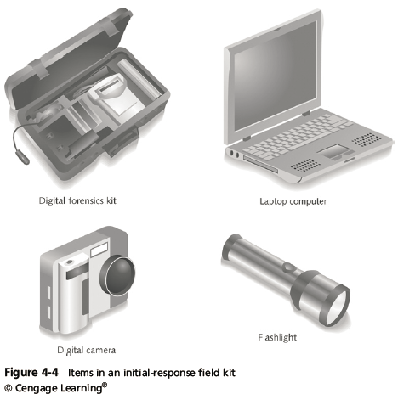
Determining the Tools You Need
Guide to Computer Forensics and Investigations Fifth Edition
Notes:
Determining the Tools You Need
Figure 4-4 Items in an initial-response field kit

Slide 34
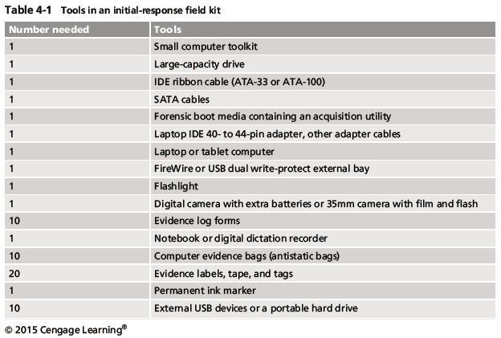
Determining the Tools You Need
Guide to Computer Forensics and Investigations Fifth Edition
Notes:
Determining the Tools You Need
Table 4-1 Tools in an initial-response field kit

Slide 35
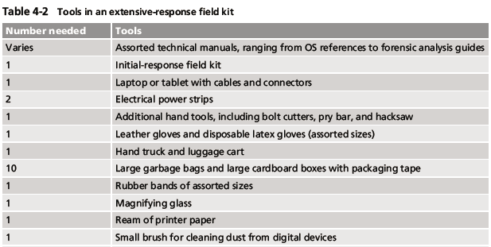
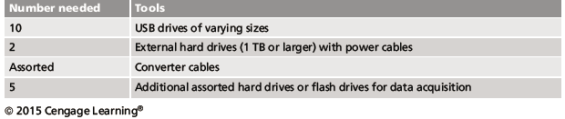
Determining the Tools You Need
Guide to Computer Forensics and Investigations Fifth Edition
Notes:
Determining the Tools You Need
Table 4-2 Tools in an extensive-response field kit

Slide 36
Preparing the Investigation Team
Before initiating the search:
  Review facts, plans, and objectives with the investigation team you have assembled
Goal of scene processing
  To collect and secure digital evidence
Digital evidence is volatile
  Develop skills to assess facts quickly
Slow response can cause digital evidence to be lost
Guide to Computer Forensics and Investigations Fifth Edition
Notes:
Preparing the Investigation Team
Before initiating the search:
Review facts, plans, and objectives with the investigation team you have assembled
Goal of scene processing
To collect and secure digital evidence
Digital evidence is volatile
Develop skills to assess facts quickly
Slow response can cause digital evidence to be lost

Slide 37
Securing a Computer Incident or Crime Scene
Goals
  Preserve the evidence
  Keep information confidential
Define a secure perimeter
  Use yellow barrier tape
  Legal authority for a corporate incident includes trespassing violations
  For a crime scene, it includes obstructing justice or failing to comply with a police officer
Guide to Computer Forensics and Investigations Fifth Edition
Notes:
Securing a Computer Incident or Crime Scene
Goals
Preserve the evidence
Keep information confidential
Define a secure perimeter
Use yellow barrier tape
Legal authority for a corporate incident includes trespassing violations
For a crime scene, it includes obstructing justice or failing to comply with a police officer

Slide 38
Securing a Computer Incident or Crime Scene
Professional curiosity can destroy evidence
  Involves police officers and other professionals who aren’t part of the crime scene processing team
Automated Fingerprint Identification System (AFIS)
  A computerized system for identifying fingerprints that’s connected to a central database
  Used to identify criminal suspects and review thousands of fingerprint samples at high speed
Police can take elimination prints of everyone who had access to the crime scene
Guide to Computer Forensics and Investigations Fifth Edition
Notes:
Securing a Computer Incident or Crime Scene
Professional curiosity can destroy evidence
Involves police officers and other professionals who aren’t part of the crime scene processing team
Automated Fingerprint Identification System (AFIS)
A computerized system for identifying fingerprints that’s connected to a central database
Used to identify criminal suspects and review thousands of fingerprint samples at high speed
Police can take elimination prints of everyone who had access to the crime scene

Slide 39
Seizing Digital Evidence at the Scene
Law enforcement can seize evidence
  With a proper warrant
Corporate investigators might have the authority only to make an image of the suspect’s drive
When seizing digital evidence in criminal investigations
  Follow U.S. DoJ standards for seizing digital data
Civil investigations follow same rules
  Require less documentation though
Consult with your attorney for extra guidelines
DoJ ➔ Department of Justice
Guide to Computer Forensics and Investigations Fifth Edition
Notes:
Seizing Digital Evidence at the Scene
Law enforcement can seize evidence
With a proper warrant
Corporate investigators might have the authority only to make an image of the suspect’s drive
When seizing digital evidence in criminal investigations
Follow U.S. DoJ standards for seizing digital data
Civil investigations follow same rules
Require less documentation though
Consult with your attorney for extra guidelines

Slide 40
Preparing to Acquire Digital Evidence
The evidence you acquire at the scene depends on the nature of the case
  And the alleged crime or violation
Ask your supervisor or senior forensics examiner in your organization the following questions:
  Do you need to take the entire computer and all peripherals and media in the immediate area?
  How are you going to protect the computer and media while transporting them to your lab?
  Is the computer powered on when you arrive?
Guide to Computer Forensics and Investigations Fifth Edition
Notes:
Preparing to Acquire Digital Evidence
The evidence you acquire at the scene depends on the nature of the case
And the alleged crime or violation
Ask your supervisor or senior forensics examiner in your organization the following questions:
Do you need to take the entire computer and all peripherals and media in the immediate area?
How are you going to protect the computer and media while transporting them to your lab?
Is the computer powered on when you arrive?

Slide 41
Preparing to Acquire Digital Evidence
Ask your supervisor or senior forensics examiner in your organization the following questions (cont’d):
  Is the suspect you’re investigating in the immediate area of the computer?
  Is it possible the suspect damaged or destroyed the computer, peripherals, or media?
  Will you have to separate the suspect from the computer?
Guide to Computer Forensics and Investigations Fifth Edition
Notes:
Preparing to Acquire Digital Evidence
Ask your supervisor or senior forensics examiner in your organization the following questions (cont’d):
Is the suspect you’re investigating in the immediate area of the computer?
Is it possible the suspect damaged or destroyed the computer, peripherals, or media?
Will you have to separate the suspect from the computer?

Slide 42
Processing an Incident or Crime Scene
Guidelines
  Keep a journal to document your activities
  Secure the scene
    Be professional and courteous with onlookers
    Remove people who are not part of the investigation
  Take video and still recordings of the area around the computer
    Pay attention to details
  Sketch the incident or crime scene
  Check state of computers as soon as possible
Guide to Computer Forensics and Investigations Fifth Edition
Notes:
Processing an Incident or Crime Scene
Guidelines
Keep a journal to document your activities
Secure the scene
Be professional and courteous with onlookers
Remove people who are not part of the investigation
Take video and still recordings of the area around the computer
Pay attention to details
Sketch the incident or crime scene
Check state of computers as soon as possible

Slide 43
Processing an Incident or Crime Scene
Guidelines (cont’d)
  Don’t cut electrical power to a running system unless it’s an older Windows 9x or MS-DOS system
  Save data from current applications as safely as possible
  Record all active windows or shell sessions
  Make notes of everything you do when copying data from a live suspect computer
  Close applications and shut down the computer
Guide to Computer Forensics and Investigations Fifth Edition
Notes:
Processing an Incident or Crime Scene
Guidelines (cont’d)
Don’t cut electrical power to a running system unless it’s an older Windows 9x or MS-DOS system
Save data from current applications as safely as possible
Record all active windows or shell sessions
Make notes of everything you do when copying data from a live suspect computer
Close applications and shut down the computer

Slide 44
Processing an Incident or Crime Scene
Guidelines (cont’d)
  Bag and tag the evidence, following these steps:
    Assign one person to collect and log all evidence
    Tag all evidence you collect with the current date and time, serial numbers or unique features, make and model, and the name of the person who collected it
    Maintain two separate logs of collected evidence
    Maintain constant control of the collected evidence and the crime or incident scene
Guide to Computer Forensics and Investigations Fifth Edition
Notes:
Processing an Incident or Crime Scene
Guidelines (cont’d)
Bag and tag the evidence, following these steps:
Assign one person to collect and log all evidence
Tag all evidence you collect with the current date and time, serial numbers or unique features, make and model, and the name of the person who collected it
Maintain two separate logs of collected evidence
Maintain constant control of the collected evidence and the crime or incident scene

Slide 45
Processing an Incident or Crime Scene
Guidelines (cont’d)
  Look for information related to the investigation
    Passwords, passphrases, PINs, bank accounts
  Collect documentation and media related to the investigation
    Hardware, software, backup media, documentation, manuals
Guide to Computer Forensics and Investigations Fifth Edition
Notes:
Processing an Incident or Crime Scene
Guidelines (cont’d)
Look for information related to the investigation
Passwords, passphrases, PINs, bank accounts
Collect documentation and media related to the investigation
Hardware, software, backup media, documentation, manuals

Slide 46
Processing Data Centers with RAID Systems
Sparse acquisition
  Technique for extracting evidence from large systems
  Extracts only data related to evidence for your case from allocated files
    And minimizes how much data you need to analyze
Drawback of this technique
  It doesn’t recover data in free or slack space
Guide to Computer Forensics and Investigations Fifth Edition
Notes:
Free space refers to the unallocated space on a storage device where no active file is currently stored. This space is available for new files or data.
Slack space is the unused space within a file's allocated storage cluster. It results from the difference between the actual size of the file and the size of the cluster it occupies.
Processing Data Centers with RAID Systems
Sparse acquisition
Technique for extracting evidence from large systems
Extracts only data related to evidence for your case from allocated files
And minimizes how much data you need to analyze
Drawback of this technique
It doesn’t recover data in free or slack space

Slide 47
Using a Technical Advisor
A technical advisor can help:
  List the tools you need to process the incident or crime scene
  Guide you about where to locate data and helping you extract log records
    Or other evidence from large RAID servers
  Create the search warrant by itemizing what you need for the warrant
Guide to Computer Forensics and Investigations Fifth Edition
Notes:
Using a Technical Advisor
A technical advisor can help:
List the tools you need to process the incident or crime scene
Guide you about where to locate data and helping you extract log records
Or other evidence from large RAID servers
Create the search warrant by itemizing what you need for the warrant

Slide 48
Using a Technical Advisor
Responsibilities
  Know all aspects of the seized system
  Direct investigator handling sensitive material
  Help secure the scene
  Help document the planning strategy
  Conduct ad hoc trainings
  Document activities
  Help conduct the search and seizure
Guide to Computer Forensics and Investigations Fifth Edition
Notes:
Using a Technical Advisor
Responsibilities
Know all aspects of the seized system
Direct investigator handling sensitive material
Help secure the scene
Help document the planning strategy
Conduct ad hoc trainings
Document activities
Help conduct the search and seizure

Slide 49
Documenting Evidence in the Lab
Record your activities and findings as you work
  Maintain a journal to record the steps you take as you process evidence
Your goal is to be able to reproduce the same results
  When you or another investigator repeat the steps you took to collect evidence
A journal serves as a reference that documents the methods you used to process digital evidence
Guide to Computer Forensics and Investigations Fifth Edition
Notes:
Documenting Evidence in the Lab
Record your activities and findings as you work
Maintain a journal to record the steps you take as you process evidence
Your goal is to be able to reproduce the same results
When you or another investigator repeat the steps you took to collect evidence
A journal serves as a reference that documents the methods you used to process digital evidence

Slide 50
Processing and Handling Digital Evidence
Maintain the integrity of digital evidence in the lab
  As you do when collecting it in the field
Steps to create image files:
  Copy all image files to a large drive
  Start your forensics tool to analyze the evidence
  Run an MD5 or SHA-1 hashing algorithm on the image files to get a digital hash
  Secure the original media in an evidence locker
Guide to Computer Forensics and Investigations Fifth Edition
Notes:
Processing and Handling Digital Evidence
Maintain the integrity of digital evidence in the lab
As you do when collecting it in the field
Steps to create image files:
Copy all image files to a large drive
Start your forensics tool to analyze the evidence
Run an MD5 or SHA-1 hashing algorithm on the image files to get a digital hash
Secure the original media in an evidence locker

Slide 51
Storing Digital Evidence
The media you use to store digital evidence usually depends on how long you need to keep it
CDs, DVDs, DVD-Rs, DVD+Rs, or DVD-RWs
  The ideal media
  Capacity: up to 17 GB
  Lifespan: 2 to 5 years
Magnetic tapes - 4-mm DAT
  Capacity: 40 to 72 GB
  Lifespan: 30 years
  Costs: drive: $400 to $800; tape: $40
Guide to Computer Forensics and Investigations Fifth Edition
Notes:
Storing Digital Evidence
The media you use to store digital evidence usually depends on how long you need to keep it
CDs, DVDs, DVD-Rs, DVD+Rs, or DVD-RWs
The ideal media
Capacity: up to 17 GB
Lifespan: 2 to 5 years
Magnetic tapes - 4-mm DAT
Capacity: 40 to 72 GB
Lifespan: 30 years
Costs: drive: $400 to $800; tape: $40

Slide 52
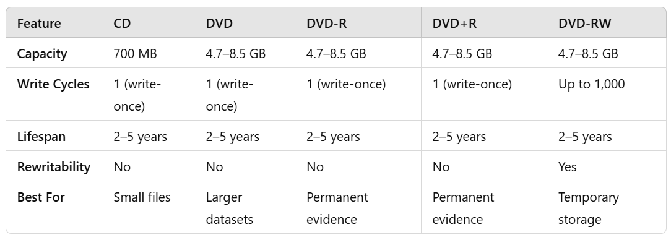
DVD+R : Similar to DVD-R but with improved error correction
Guide to Computer Forensics and Investigations Fifth Edition

Slide 53
Storing Digital Evidence
Super Digital Linear Tape (Super-DLT or SDLT)
  Specifically designed for large RAID data backups
  Can store more than 1 TB of data
Smaller external SDLT drives can connect to a workstation through a SCSI card
Don’t rely on one media storage method to preserve your evidence
  Make two copies of every image to prevent data loss
  Use different tools to create the two images
Guide to Computer Forensics and Investigations Fifth Edition
Notes:
Storing Digital Evidence
Super Digital Linear Tape (Super-DLT or SDLT)
Specifically designed for large RAID data backups
Can store more than 1 TB of data
Smaller external SDLT drives can connect to a workstation through a SCSI card
Don’t rely on one media storage method to preserve your evidence
Make two copies of every image to prevent data loss
Use different tools to create the two images

Slide 54
Evidence Retention and Media Storage Needs
To help maintain the chain of custody for digital evidence
  Restrict access to lab and evidence storage area
Lab should have a sign-in roster for all visitors
  Maintain logs for a period based on legal requirements
You might need to retain evidence indefinitely
  Check with your local prosecuting attorney’s office or state laws to make sure you’re in compliance
Guide to Computer Forensics and Investigations Fifth Edition
Notes:
Evidence Retention and Media Storage Needs
To help maintain the chain of custody for digital evidence
Restrict access to lab and evidence storage area
Lab should have a sign-in roster for all visitors
Maintain logs for a period based on legal requirements
You might need to retain evidence indefinitely
Check with your local prosecuting attorney’s office or state laws to make sure you’re in compliance

Slide 55
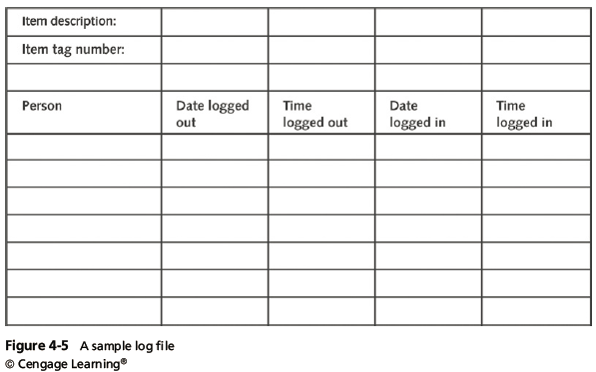
Evidence Retention and Media Storage Needs
Guide to Computer Forensics and Investigations Fifth Edition
Notes:
Evidence Retention and Media Storage Needs
Figure 4-5 A sample log file

Slide 56
Documenting Evidence
Create or use an evidence custody form
An evidence custody form serves the following functions:
  Identifies the evidence
  Identifies who has handled the evidence
  Lists dates and times the evidence was handled
You can add more information to your form
  Such as a section listing MD5 and SHA-1 hash values
Guide to Computer Forensics and Investigations Fifth Edition
Notes:
Documenting Evidence
Create or use an evidence custody form
An evidence custody form serves the following functions:
Identifies the evidence
Identifies who has handled the evidence
Lists dates and times the evidence was handled
You can add more information to your form
Such as a section listing MD5 and SHA-1 hash values

Slide 57
Documenting Evidence
Include any detailed information you might need to reference
Evidence bags also include labels or evidence forms you can use to document your evidence
  Use antistatic bags for electronic components
Guide to Computer Forensics and Investigations Fifth Edition
Notes:
Documenting Evidence
Include any detailed information you might need to reference
Evidence bags also include labels or evidence forms you can use to document your evidence
Use antistatic bags for electronic components

Slide 58
Obtaining a Digital Hash
Cyclic Redundancy Check (CRC)
  Mathematical algorithm that determines whether a file’s contents have changed
  Not considered a forensic hashing algorithm
Message Digest 5 (MD5)
  Mathematical formula that translates a file into a hexadecimal code value, or a hash value
  If a bit or byte in the file changes, it alters the hash value, which can be used to verify a file or drive has not been tampered with
Guide to Computer Forensics and Investigations Fifth Edition
Notes:
Obtaining a Digital Hash
Cyclic Redundancy Check (CRC)
Mathematical algorithm that determines whether a file’s contents have changed
Not considered a forensic hashing algorithm
Message Digest 5 (MD5)
Mathematical formula that translates a file into a hexadecimal code value, or a hash value
If a bit or byte in the file changes, it alters the hash value, which can be used to verify a file or drive has not been tampered with

Slide 59
Obtaining a Digital Hash
Three rules for forensic hashes:
  You can’t predict the hash value of a file or device
  No two hash values can be the same
  If anything changes in the file or device, the hash value must change
Secure Hash Algorithm version 1 (SHA-1)
  A newer hashing algorithm
  Developed by the National Institute of Standards and Technology (NIST)
Guide to Computer Forensics and Investigations Fifth Edition
Notes:
Obtaining a Digital Hash
Three rules for forensic hashes:
You can’t predict the hash value of a file or device
No two hash values can be the same
If anything changes in the file or device, the hash value must change
Secure Hash Algorithm version 1 (SHA-1)
A newer hashing algorithm
Developed by the National Institute of Standards and Technology (NIST)

Slide 60
Obtaining a Digital Hash
In both MD5 and SHA-1, collisions have occurred
Most digital forensics hashing needs can be satisfied with a nonkeyed hash set
  A unique hash number generated by a software tool, such as the Linux md5sum command
Keyed hash set
  Created by an encryption utility’s secret key
You can use the MD5 function in FTK Imager to obtain the digital signature of a file
  Or an entire drive
Guide to Computer Forensics and Investigations Fifth Edition
Notes:
Obtaining a Digital Hash
In both MD5 and SHA-1, collisions have occurred
Most digital forensics hashing needs can be satisfied with a nonkeyed hash set
A unique hash number generated by a software tool, such as the Linux md5sum command
Keyed hash set
Created by an encryption utility’s secret key
You can use the MD5 function in FTK Imager to obtain the digital signature of a file
Or an entire drive

Slide 61
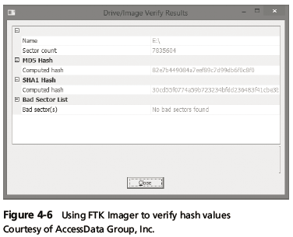
Obtaining a Digital Hash
Guide to Computer Forensics and Investigations Fifth Edition
Notes:
Obtaining a Digital Hash
Figure 4-6 Using FTK Imager to verify hash values

Slide 62
Reviewing a Case
General tasks you perform in any computer forensics case:
  Identify the case requirements
  Plan your investigation
  Conduct the investigation
  Complete the case report
  Critique the case
Guide to Computer Forensics and Investigations Fifth Edition
Notes:
Reviewing a Case
General tasks you perform in any computer forensics case:
Identify the case requirements
Plan your investigation
Conduct the investigation
Complete the case report
Critique the case

Slide 63
Sample Civil Investigation
Most cases in the corporate environment are considered low-level investigations
  Or noncriminal cases
Common activities and practices
  Recover specific evidence
    Suspect’s Outlook e-mail folder (PST file)
  Covert surveillance
    Its use must be well defined in the company policy
    Risk of civil or criminal liability
  Sniffing tools for data transmissions
Guide to Computer Forensics and Investigations Fifth Edition
Notes:
Sample Civil Investigation
Most cases in the corporate environment are considered low-level investigations
Or noncriminal cases
Common activities and practices
Recover specific evidence
Suspect’s Outlook e-mail folder (PST file)
Covert surveillance
Its use must be well defined in the company policy
Risk of civil or criminal liability
Sniffing tools for data transmissions

Slide 64
Sample Criminal Investigation
Computer crimes examples
  Fraud
  Check fraud
  Homicides
Need a warrant to start seizing evidence
  Limit searching area
Guide to Computer Forensics and Investigations Fifth Edition
Notes:
Sample Criminal Investigation
Computer crimes examples
Fraud
Check fraud
Homicides
Need a warrant to start seizing evidence
Limit searching area

Slide 65
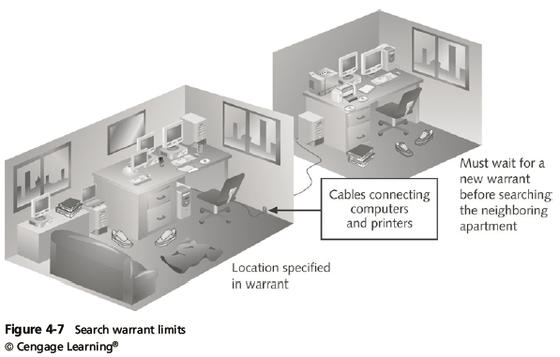
Sample Criminal Investigation
Guide to Computer Forensics and Investigations Fifth Edition
Notes:
Sample Criminal Investigation
Figure 4-7 Search warrant limits

Slide 66
Summary
Digital evidence is anything stored or transmitted on electronic or optical media
In the private sector, incident scene is often in a contained and controlled area
Companies should publish the right to inspect computer assets policy
Private and public sectors follow same computing investigation rules
Criminal cases
  Require warrants
Guide to Computer Forensics and Investigations Fifth Edition
Notes:
Summary
Digital evidence is anything stored or transmitted on electronic or optical media
In the private sector, incident scene is often in a contained and controlled area
Companies should publish the right to inspect computer assets policy
Private and public sectors follow same computing investigation rules
Criminal cases
Require warrants

Slide 67
Summary
Protect your safety and health as well as the integrity of the evidence
Follow guidelines when processing an incident or crime scene
  Security perimeter
  Video recording
As you collect digital evidence, guard against physically destroying or contaminating it
Forensic hash values verify that data or storage media have not been altered
Guide to Computer Forensics and Investigations Fifth Edition
Notes:
Summary
Protect your safety and health as well as the integrity of the evidence
Follow guidelines when processing an incident or crime scene
Security perimeter
Video recording
As you collect digital evidence, guard against physically destroying or contaminating it
Forensic hash values verify that data or storage media have not been altered

Slide 68
Summary
To analyze computer forensics data, learn to use more than one vendor tool
You must handle all evidence the same way every time you handle it
After you determine that an incident scene has digital evidence, identify the digital information or artifacts that can be used as evidence
Guide to Computer Forensics and Investigations Fifth Edition
Notes:
Summary
To analyze computer forensics data, learn to use more than one vendor tool
You must handle all evidence the same way every time you handle it
After you determine that an incident scene has digital evidence, identify the digital information or artifacts that can be used as evidence

